Slide 1
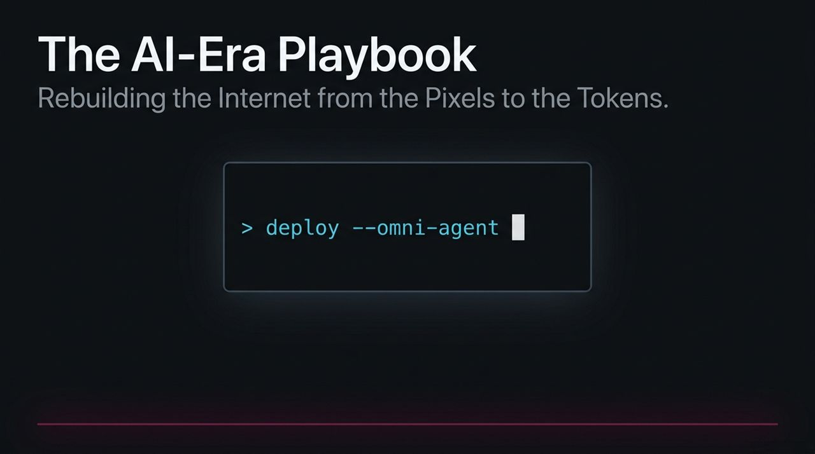
Notes:
Welcome everyone. Today we are unpacking 'The AI-Era Playbook,' which details how Vercel and modern high-growth tech organizations are rebuilding the internet from pixels to tokens.
For the past decade, if you built on the internet, you’ve touched Vercel's platform—from Next.js to front-end hosting for companies like OpenAI, Stripe, and Nike. But today, AI is fundamentally changing not just who builds software, but how companies themselves are architected and scaled.
In this presentation, we’ll move beyond superficial hype and break down the operational playbook required to lead in this new landscape: from recursive founder structures and hyper-efficient talent density, to managing agentic workflows and liquid token infrastructure.
https://www.youtube.com/watch?v=DdbCtAScTsk

Slide 2
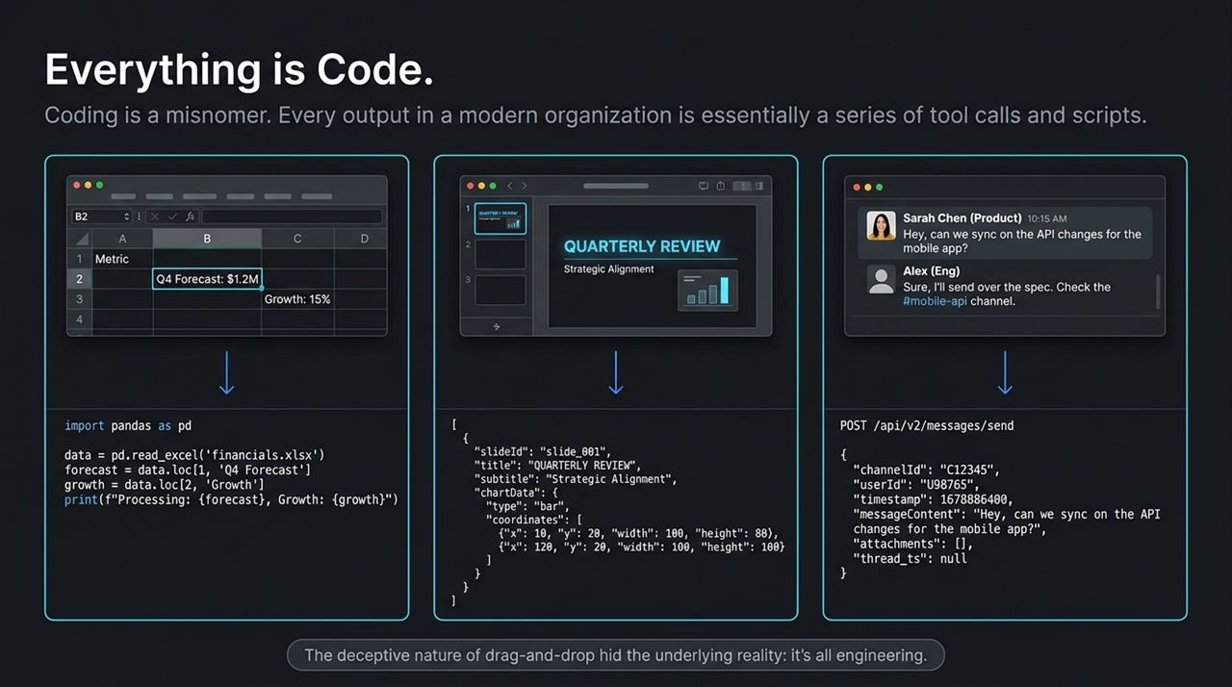
Notes:
Let's start with a provocative premise: coding is actually a misnomer. Every output in a modern organization is essentially a series of tool calls and scripts.
Guillermo points out that for years, software obscured this reality with deceptive drag-and-drop interfaces. When you edit an Excel spreadsheet, build a slide deck, or post a Slack message, you are manipulating structured data and triggering tool calls under the hood.
Because AI coding agents now account for the vast majority of global token volume on platforms like Vercel's AI Gateway, we must recognize that everything inside a business can—and should—be engineered. When you apply an engineering mindset to company operations, you stop viewing departments as isolated silos and start seeing them as programmable workflows.

Slide 3
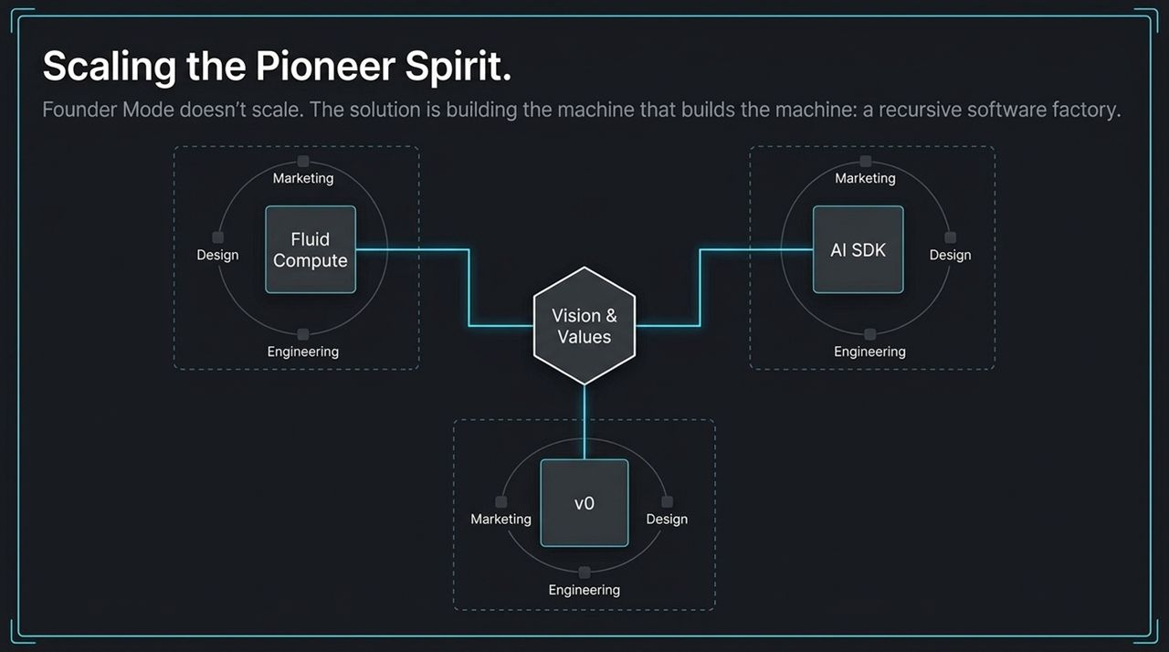
Notes:
In late 2024, Paul Graham sparked a global conversation around 'Founder Mode'—the idea that founders must stay deep in the weeds, drive extreme urgency, and reject middle-management friction. But as Guillermo Rauch observed, traditional Founder Mode doesn't scale across multi-product organizations. A single founder cannot oversee millions of customers and dozens of product lines alone.
Vercel’s answer is Recursive Founder Mode. Instead of relying on one founder, you build the 'machine that builds the machine'. You recruit and foster autonomous product owners who embody the founder spirit—people like Lars Stroemgard (AI SDK) or Tom Leonard (Fluid Compute).
These leaders take full end-to-end ownership. They control their product design, marketing, communications, and runtime engineering on top of the Vercel platform. They operate as CEOs of their own internal startups.

Slide 4
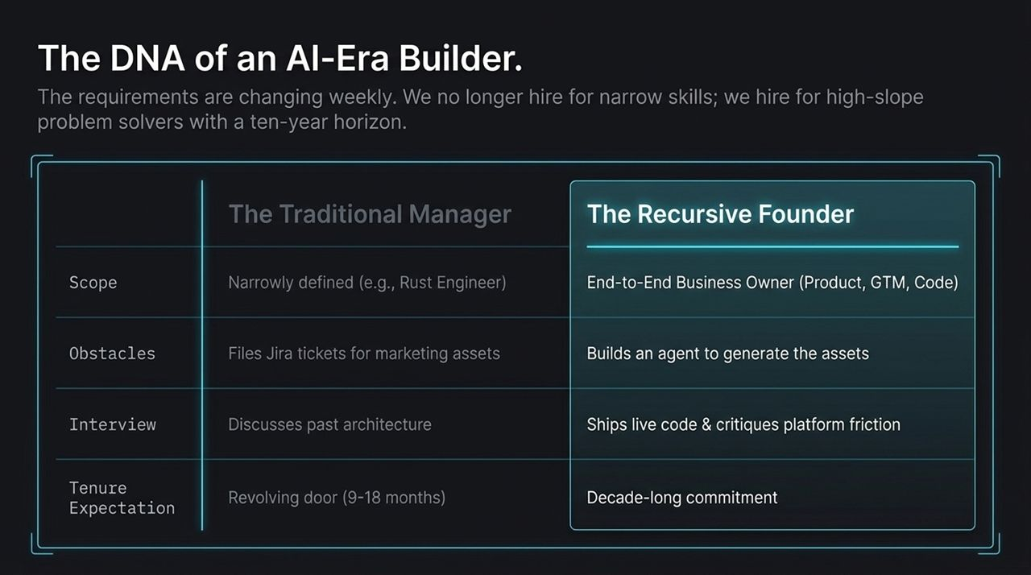
Notes:
How do you hire for Recursive Founder Mode? The criteria are shifting weekly. We no longer hire for narrow skills; models can already write specialized code exceptionally well. Instead, we hire for high-slope problem solvers with long-term commitment.
Look at the contrast on this slide: Traditional managers file Jira tickets to request marketing assets. Recursive builders build an agent to auto-generate those assets. Traditional candidates talk about past architecture; AI-era builders ship live code during the interview and give feedback on where platform friction slowed them down.
Furthermore, in our interview process, we make it clear that building a generational company requires intense dedication—a decade-long horizon, not a revolving-door stint of 9 to 18 months.

Slide 5
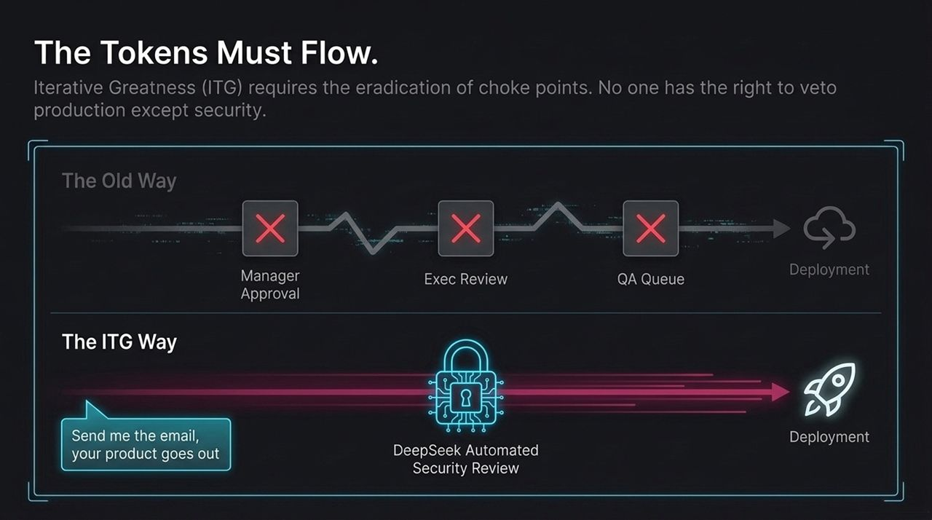
Notes:
One of Vercel’s core cultural values is Iterative Greatness (ITG). The Dune quote 'the spice must flow' becomes 'the tokens must flow, the products must be shipped'.
In traditional corporate setups, deployment is locked behind endless queues: manager approvals, executive reviews, QA hold-ups, and bureaucratic delays. That 'send me the email and I'll review it when I have time' mindset destroys momentum.
Under the ITG framework, we eliminate veto points. No one in the company has the right to block production except Security. Automated security reviews like DeepSeek evaluate code automatically. The onus is on continuous deployment and rapid feedback loops with real users.

Slide 6
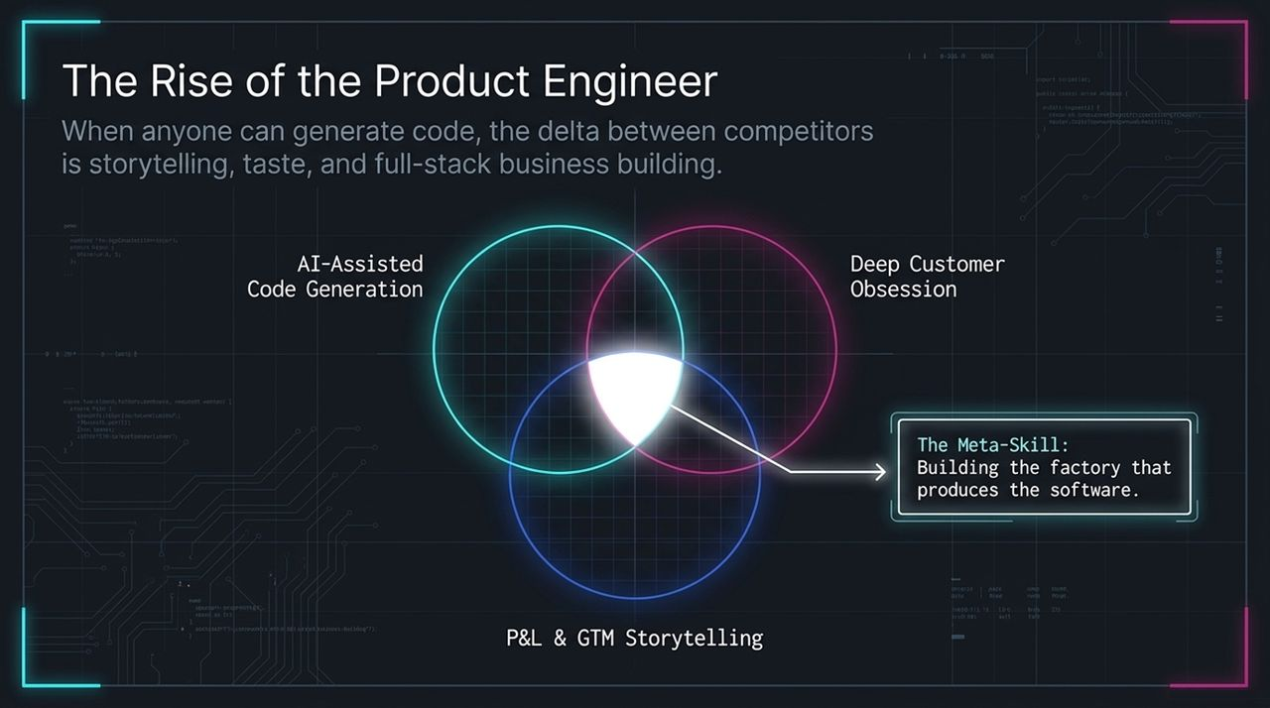
Notes:
As code generation becomes commoditized, what differentiates successful companies? It’s what Lee Robinson calls 'The Rise of the Product Engineer'.
When anyone can prompt an LLM to output working software, technical syntax is no longer the bottleneck. The key competitive delta shifts to deep customer obsession, taste, P&L storytelling, and market positioning.
A Product Engineer doesn't just ask 'how do I write this function?'; they ask 'how does this feature impact churn, retention, and conversion?' The ultimate meta-skill of the modern era is building the software factory that produces the product, rather than hand-crafting every line manually.

Slide 7
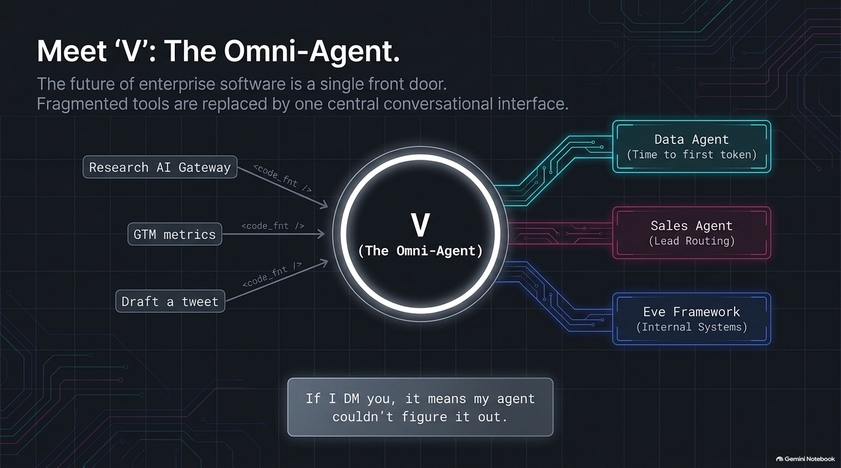
Notes:
Instead of forcing employees to navigate dozens of isolated browser tabs and SaaS dashboards, Vercel developed 'V'—our central Omni-Agent built on top of the open-source Eve framework.
V acts as a single front door for the entire enterprise. Whether you need to run a data query (Time to First Token), route a sales lead, check GTM metrics, or perform code tasks, you talk to V directly in Slack.
Under the hood, V orchestrates specialized sub-agents across data, sales, and internal systems. Guillermo joke-tweets internally: 'If I DM you, it means my agent couldn't figure it out.' That reflects our default posture: consult AI first, human second.

Slide 8
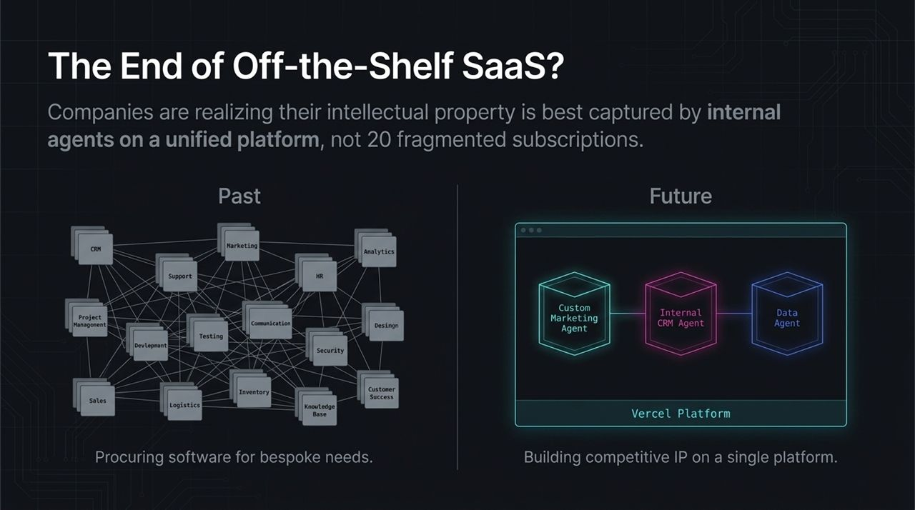
Notes:
Are we witnessing the end of off-the-shelf SaaS? Not entirely, but the enterprise buying strategy is transforming rapidly.
In the past, companies subscribed to dozens of disconnected SaaS tools for CRM, support, analytics, project management, and design. Today, organizations realize that rigid, static third-party software cannot match custom, internal agentic workflows built on their own IP.
Instead of buying 20 fragmented subscriptions, businesses are consolidating onto single infrastructure platforms (like Vercel) where they deploy custom agents tailored specifically to their proprietary data and processes. Vendor software that lacks fast, low-latency agent interoperability faces elimination.

Slide 9
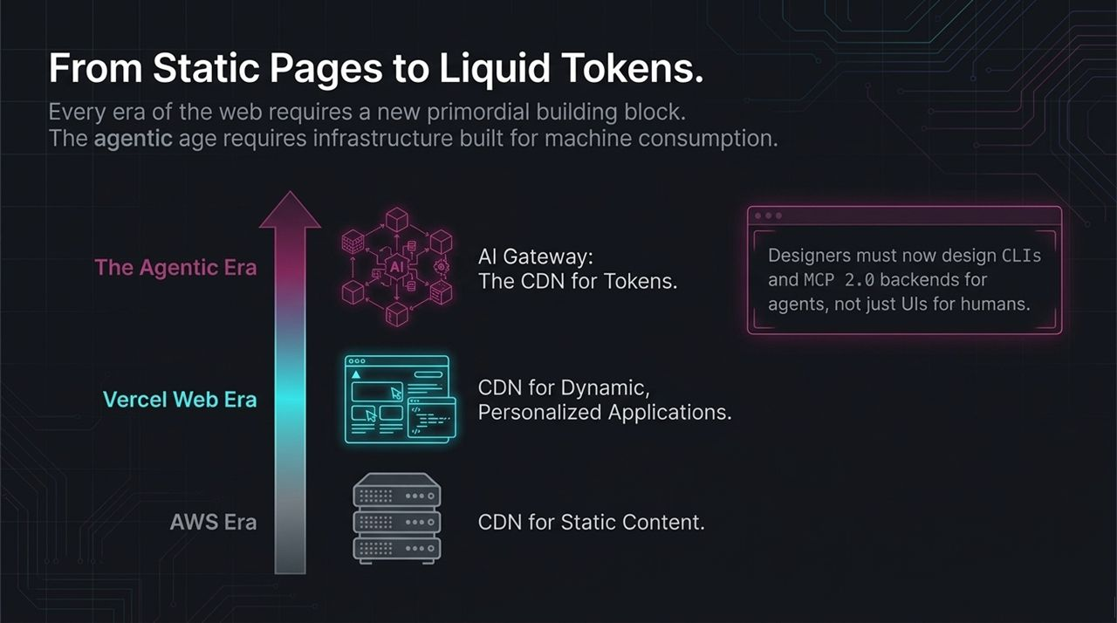
Notes:
Every paradigm shift on the internet requires a new primordial building block.
In the early AWS era, infrastructure focused on Content Delivery Networks (CDNs) for static files. During the modern Vercel web era, we pioneered global edge networks optimized for dynamic, personalized, and SSR web applications.
Now, in the Agentic Era, tokens are the fundamental unit of compute. The AI Gateway functions as the 'CDN for Tokens'—routing model traffic, caching responses, reducing latency, and handling fallbacks. Software interfaces are shifting too: designers must now design CLIs and MCP 2.0 backends optimized for AI agents, not just visual graphical UIs for human eyes.

Slide 10
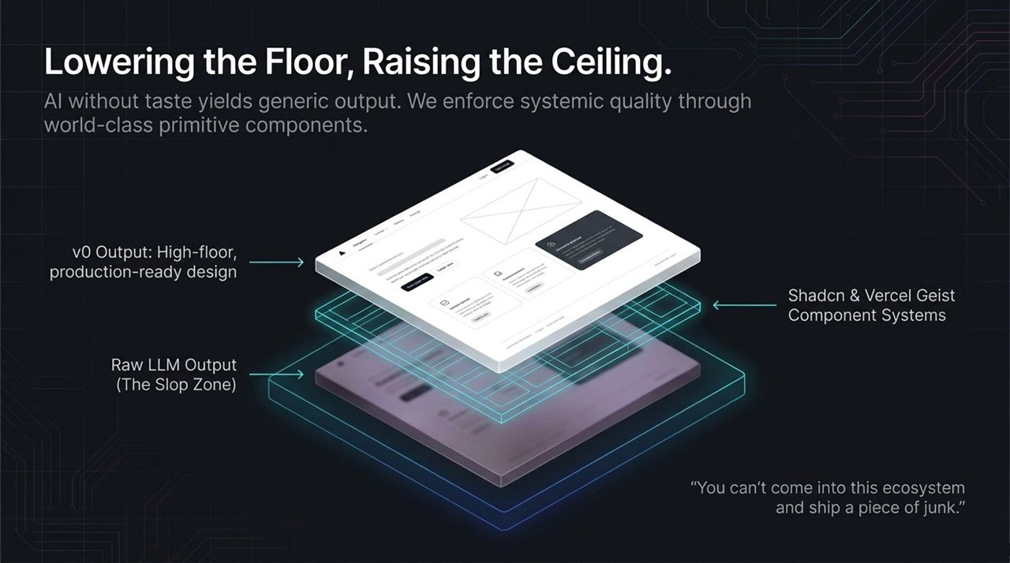
Notes:
AI tools allow anyone to generate software instantly, but unconstrained LLMs tend to produce low-quality, generic outputs—what Guillermo calls 'the slop zone' (e.g., cliché purple gradients and bad typography).
To combat this, Vercel focuses on raising the floor while keeping the ceiling uncapped. Tools like v0, Shadcn UI, and Vercel Geist design systems serve as world-class primitives.
When AI models build on top of structured component systems, the generated output is production-ready and aesthetically refined right out of the box. As Guillermo emphasizes, 'You can't come into this ecosystem and ship a piece of junk'—we use automated skills and design system rules to de-slopify generated code automatically.

Slide 11
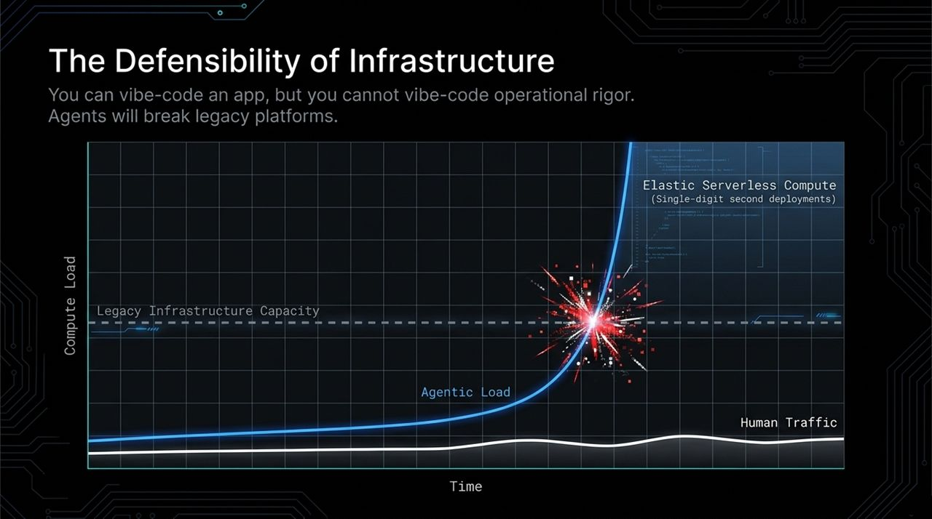
Notes:
Can startups build lasting moats when AI makes app development so easy? The answer lies in infrastructure. You can vibe-code an application UI in a weekend, but you cannot vibe-code operational rigor, security compliance, or global edge performance.
Unlike human traffic—which follows predictable peak and off-peak curves—autonomous AI agents generate intense, continuous, high-concurrency request loads. Agents quering APIs at 100 requests per second will immediately overwhelm legacy hosting architectures.
Elastic serverless compute that deploys in single-digit seconds is essential for sustaining agentic traffic spikes without service interruptions.

Slide 12
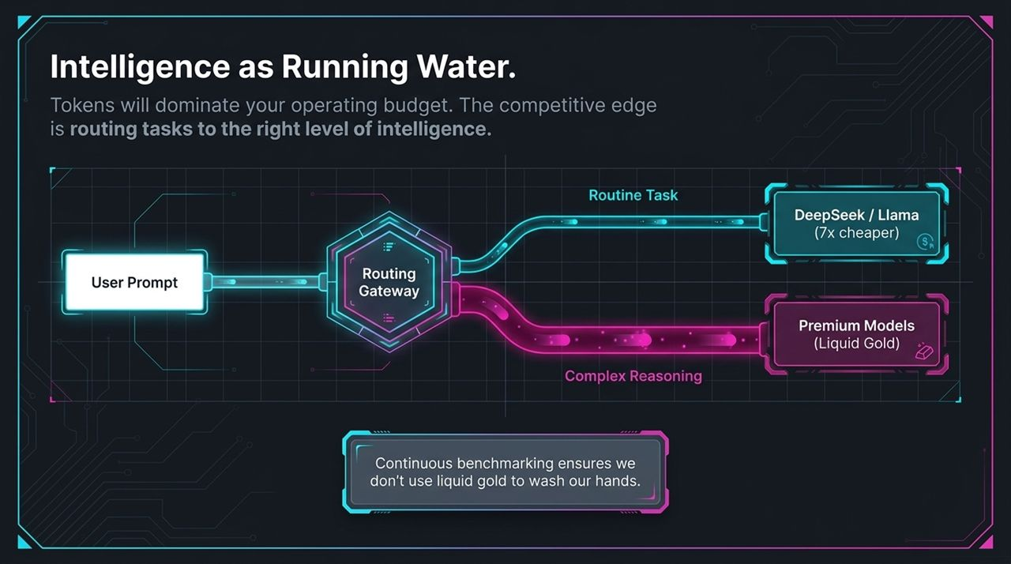
Notes:
Guillermo notes that AI intelligence is becoming as accessible as running water—or liquid gold. However, because tokens will dominate your operating budget, cost-effective routing is critical.
Not every task requires an expensive top-tier model. For example, running security scans with high-end models might cost thousands of dollars per codebase, whereas utilizing newer open-weights or specialized models (like Kimi or DeepSeek) can achieve similar accuracy at a fraction of the cost.
Smart orchestration gateways automatically route user prompts based on latency, cost, and security requirements. Managing token economics efficiently is key to maintaining healthy P&L margins in an AI-driven enterprise.

Slide 13
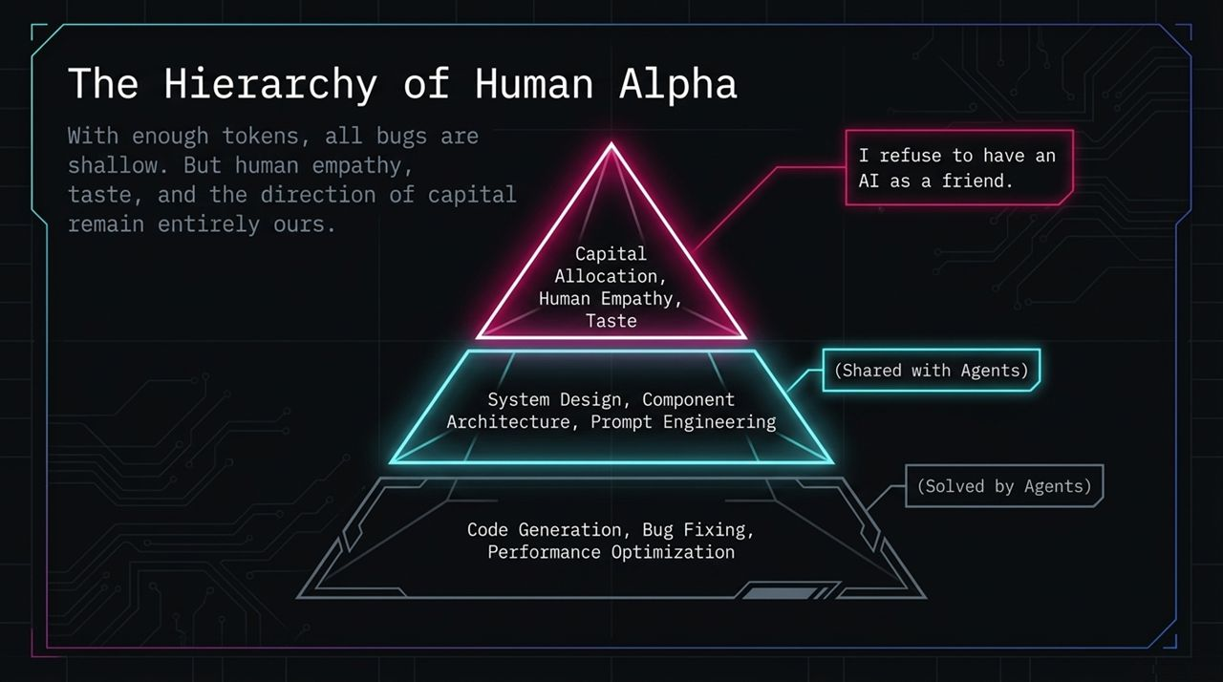
Notes:
Let's examine what a modern software factory looks like in practice. Vercel is actively transforming major open-source codebases, such as the AI SDK repository, into self-sustaining software factories.
Instead of human maintainers manually triaging every issue, user-submitted bug reports trigger autonomous agents. These agents analyze the code, test candidate fixes in secure sandboxes, and resolve up to 99% of routine issues automatically.
When underlying LLM providers release new API capabilities, reflection agents identify the updates, type-check the changes, and release platform library updates automatically. Humans shift from manual coders to factory supervisors.

Slide 14
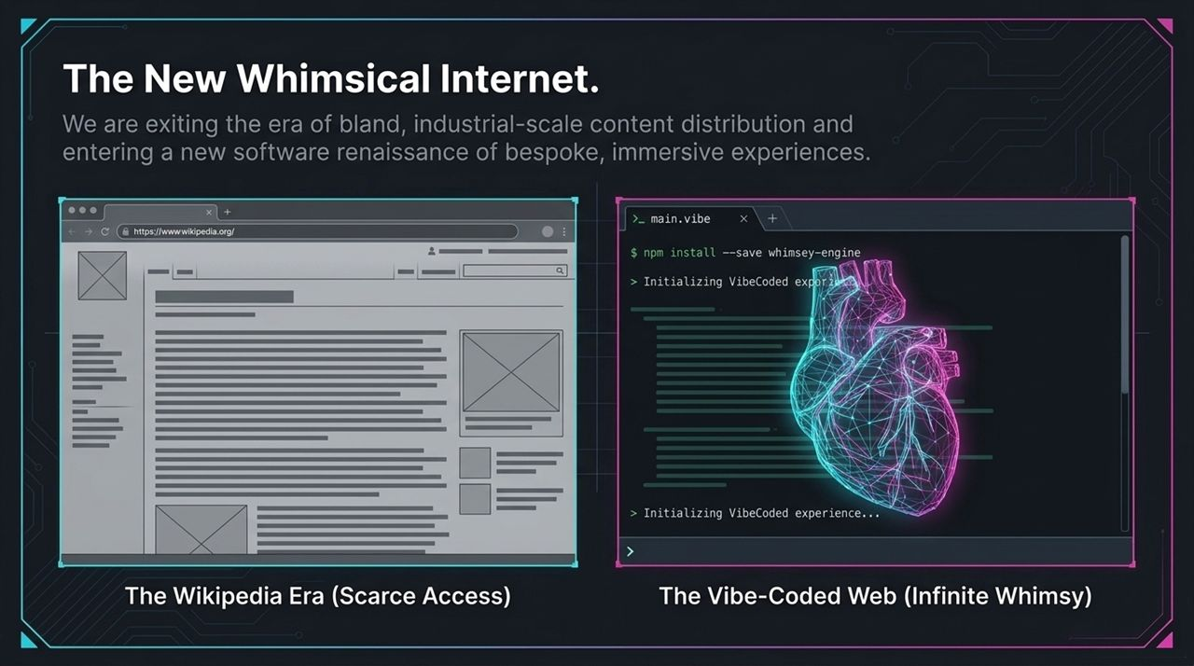
Notes:
The software factory model extends beyond engineering into Go-To-Market and Data Analytics teams.
In traditional growth models, doubling customer volume required linearly scaling data analysts and sales operations reps. By deploying dedicated GTM and Data agents, Vercel has bent the headcount curve.
In the past, employee requests for data dashboards went into a ticket queue measured by multi-day SLAs. Today, team members ask 'V', and performance is measured by Time to First Token. Data teams focus on refining access policies and training agent logic rather than repeatedly pulling manual SQL queries.

Slide 15
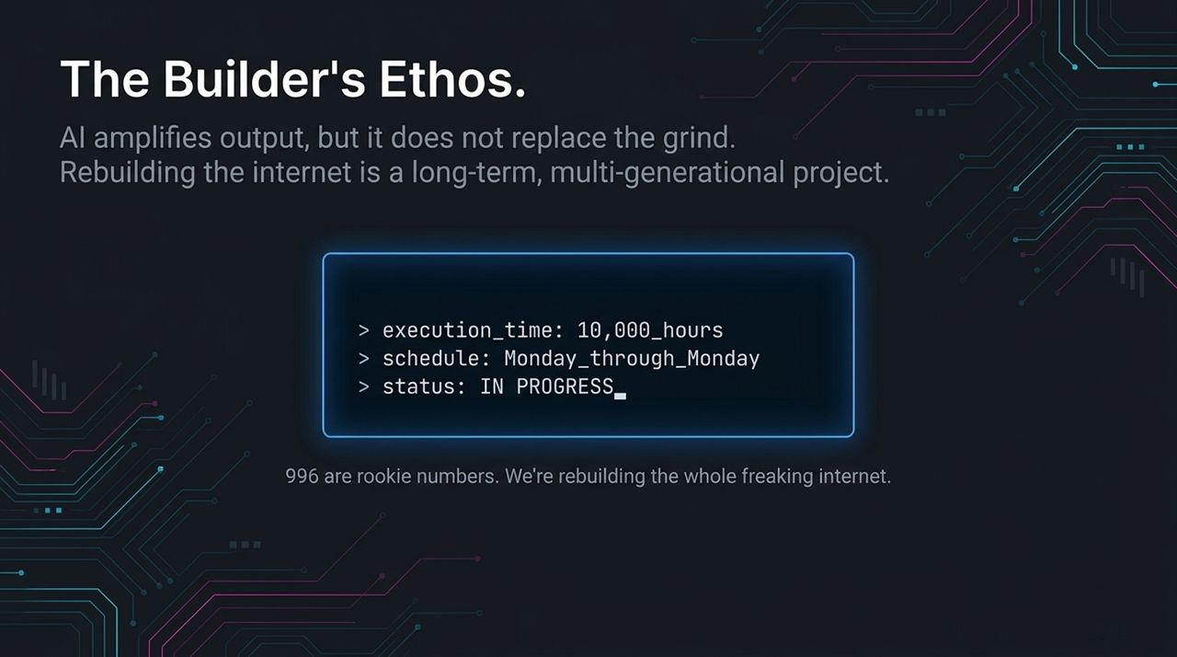
Notes:
If agents handle research, coding, analytics, and lead routing, what remains uniquely human?
Guillermo strongly emphasizes that human empathy, connection, taste, and emotional intelligence cannot be replaced by machines. While AI accelerates execution, human leaders retain control over capital allocation, corporate values, and vision.
Adapting the classic Unix adage, Guillermo notes: 'With enough tokens, all bugs, performance issues, and security flaws are shallow'. But deciding which problems are worth solving and steering token budgets toward meaningful initiatives requires human judgment.

Slide 16
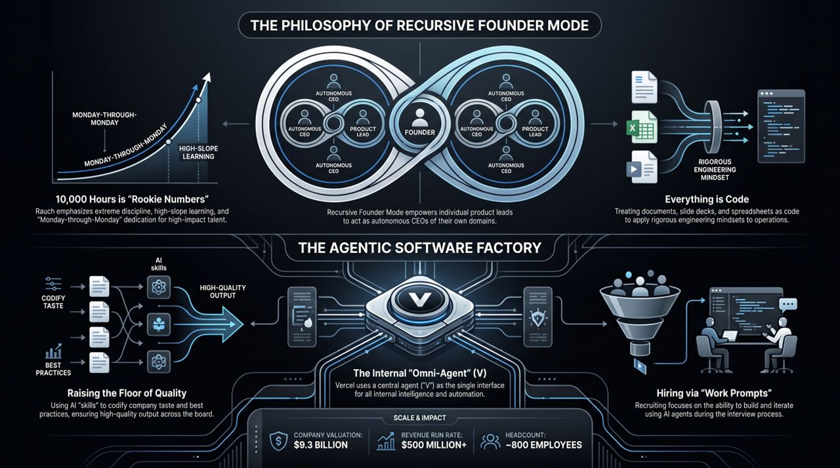
Notes:
In closing, the AI era isn't leading to a sterile, automated internet; it’s unleashing a new digital renaissance.
We are moving away from the flat, bland web of standard text templates and returning to rich, whimsical, highly interactive experiences. When creation friction drops to near zero, creators, artists, and builders can bring ambitious ideas to life almost instantaneously.
Achieving this requires intense personal discipline, high agency, and an unwavering commitment to quality. As Guillermo puts it: 'Get in—we are rebuilding the whole freaking internet from the pixels to the tokens.' Thank you.
https://www.youtube.com/watch?v=DdbCtAScTsk

